Slide 1
POV: API Management Migration
CTS IPM

Slide 2
Topics Covered
01
Product/Platform Comparison Process
Need Updates
02
Product Comparison Basics
03
Product Comparison - 1
04
Product Comparison - 2
05
Appendix

Slide 3
Consulting Approach

Slide 4
API migration lifecycle
01
ANALYZE
RATIONALIZE
02
Current landscape & API usage
APIs & KPIs
03
MIGRATE
OPTIMIZE
04
Leverage existing assets and Automate migration
Refine Target State Operations

Slide 5
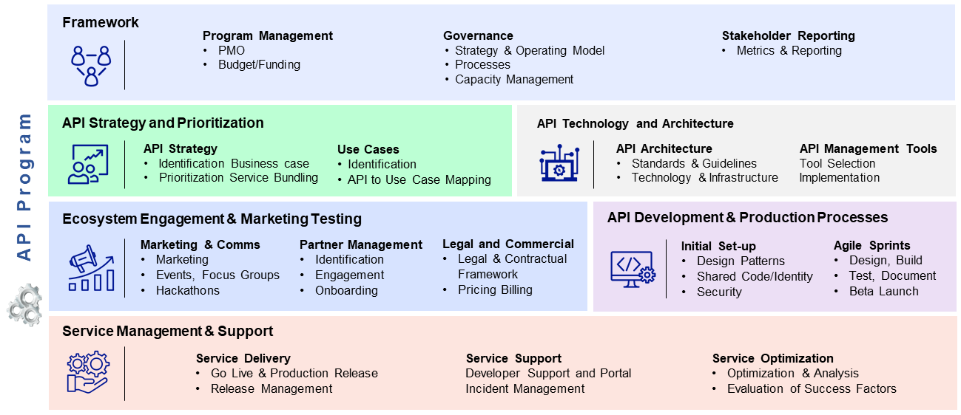
API Program (Target state)
API Program target state, aimed at establishing a strong foundation for its Enterprise API engagements. The engagement begins with development of a blueprint covering the key tenets of Planning and Scope Management, Architecture & Design, Implementation, Operations & Infrastructure. The blueprint additionally covers the dimensions of People, Process and Tools necessary for such programs.
Reference Model
Key Influencers
Business Model & Strategy
Reference Architecture & Principles
Guiding Philosophy such as a solution, product, Test driven, CI/CD, Agile Delivery
Engagement Model
Collaboration Model
Scope and Deliverables
The Program setup scope covers the API development lifecycle stages of plan, build, test, deploy, maintain and monitor
It specifically defines:
The requirement management process
The design specifications
Development Guidelines and best practices
Sprint cycles and scale
Source Code Management Strategy
Deployment Infrastructure Plan
Test Strategy
Deployment and Release Strategy
Monitoring and Operations Management

Slide 6
Product Comparison Basics

Slide 7
APIGEE Vs WSO2
Update for WSO2

Slide 8
API Product comparison – Key Parameters
Category | Capabilities | Key Parameters | WSO2
API Vendor Profiling |  | Thought Leadership, industry recognition and track record of Innovation Product Development Roadmap, provisioning of product capability online content, trainings & workshops which the vendor can facilitate, trial license availability. Supported Form Factors and ease of use. Total Cost of Ownership - Initial Cost, Cost of Support and Maintenance, Cost of Capacity Upgrades, Cost of Add-Ons | Robust online documentation One on the popular open source APIM tool Free to use and support cost is applicable
API Development and Management | Security & Policy Management API Design Mediation & Transformation Enterprise Integration | Integration with Applications or via ESB, supported protocols Security Features – OAuth, SAML, message level encryption and others. Support for Mobile Platforms and availability of out of the box platform SDKs. Support for monitoring and debugging of APIs, Caching | Support OAUTH, SAML, JWT, Federated ID, SSO Support XACML for fine grain authorization Support HTTP SOAP/REST protocol for Integration Maps between HTTP(s) and other protocols, such as JMS or writing to file systems Track consumer analytics per API, per API version, per tiers, and per consumer Threat Detection and message content filtering
API Platform Operation | Performance and Scalability Developer community management | Support for build and deployment. Platform's ability to support source control for API code and options for integrating with 3rd parties Ability to run on different base OS (i.e., RedHat, Amazon, etc.) Ability to generate system alerts and notifications when there are errors. | Ability to run on different base OS / Cloud Platform(Linux, Windows, Solaris, AWS, Azure etc.) Support on-perm and on-cloud deployment Integration multiple databases Capability to analyses the incoming events and sends real-time notifications based on the conditions configured in the node
API Analytics and Reporting | Analytics | Ability to track and record API Usage metrics Availability of an out of the box flexible reporting platform enabling custom reports, custom dashboards with the ability to measure key KPIs over multiple dimensions and filters. | Support for generating analytics per API, per API version, per tiers, and per consumer Provides statistical graphs such as API latency and API usage comparison Monitor API usage, performance and SLA compliance. Out-of-the-box support for WSO2 Data Analytics Server and Google Analytics.
Update for WSO2
Sandipan, Mani can use some of these categories to show differences between the products i.e level of customizations

Slide 9
API Product comparison – Key Parameters
Update for WSO2
Sandipan, Mani can use some of these categories to show differences between the products I.e level of customizations
Category | Capabilities | Key Parameters | WSO2
Programmability | Programming Language Support | Ability to support different programming language Extensive API’s availability support | Support of XML and Java for writing custom policies Has good support of API’s for customization Used Jaggery/HML/CSS/Javascripts for UI customizations
API Portal and Consumer Interaction Capabilities | Developer Portal | Ease of API Consumption (self service, catalog, self-service) API documentation – Ability to automatically generate dynamic documentation API Key Management(issue, revoke, suspend), developer onboarding. Ability to integrate with 3rd party identity systems such as LDAP, AD. Customization of Portal and availability of Management APIs to integrate with external Portal | UI Customization with Jaggery/JavaScript/HTML/CSS Pluggable to existing user repositories including Microsoft Active Directory, LDAP, databases, or Apache Cassandra WSO2 Key Manager effectively managing security keys Interactive API Test console Internationalization support Customizable to use 3rd Part Key manager JWT Token Generation API Store/Publisher UI customization
API Versioning & Governance Capabilities | API life Cycle Governance Monetization | API Lifecycle Management (Publish, UnPublish, deprecate) Ability to maintain multiple versions of APIs Build and release automation to various environments Runtime Governance (QoS, Traffic Management) | Customize the API lifecycle, including executing custom behavior on lifecycle transitions Support API versioning Rich set of API’s available to enable CI/CD automation Traffic Manager enforces rate limiting and dynamic throttling based on usage quotas and bandwidth quotas
Customization | Pluggable, Extensible, and Themeable | UI Customization Security Customization Custom Mediation Policies | Support Customization of theme for API store Endpoint error handler customization Support for extending mediation logic, transformation and routing Support customizing key validation by extending key validation handler Pluggable to third-party analytics systems and billing systems

Slide 10
API Management Platform Capabilities – Definition (1 of 2)
Capability | Definition [WSO2]
Developer Portal | Self service Catalog with user management feature Support Subscribing and managing API’s per-application basis Interactive console for Testing API’s Internationalization support Notifications enabled for new versions of subscribed APIs
Security & Policy Management | Threat protection, bot detection and token-fraud detection OAuth2 standard support for API access (implicit, authorization code, client credentials, password, refresh token Grant Types) Configure Single Sign-On (SSO) using SAML 2.0 for easy integration with existing web apps Plug third-party key servers in lieu of the default one, for application registration, Oauth2 token generation & validation Validate APIs payload contents against a schema Support for JWT for authentication and information exchange Supports XACML is to enable a role-based access control mechanism Capability for restrict API Access Token to domain/API’s
API Design/Prototyping | Design can be done from the publishing interface or via importing an existing Swagger 2.0 definition Supports publishing SOAP, REST, JSON, and XML style services as APIs Sample API’s are available for reuse and tailor as per need Supports deployment of prototyped API to provide early access to APIs, and get early feedback
Analytics | Track consumer analytics per API, per API version, per tiers, and per consumer Out-of-the-box support for WSO2 Data Analytics and Google Analytics. Provides statistical graphs such as API latency and API usage comparison Live Log Viewer in the API-M Admin Portal views the latest 100 logs collected from a WSO2 API Manager at any given time Monitor the performance of proxy/backend system.
API Lifecycle Governance | Manage entire API lifecycle create, publish, block, deprecate, and retire Manage API visibility and restrict access to specific partners or customers Manage API versions and deployment status by version Ability to publish APIs to a selected set of gateways in a multi-gateway environment One-click deployment to API gateway for immediate publishing
Update for WSO2

Slide 11
API Management Platform Capabilities - Definition (2 of 2)
Capability | Definition [WSO2]
Mediation & Transformation | SOAP to REST conversion. Custom sequences can be configured to achieve functionalities e.g URL Mapping, API Routing etc. Schema Validator and Threat Protector. Customizable logging framework.
Enterprise Integration | Platform capability to integrate with other enterprise systems such as Database, Mainframe, JMS/MQ and FTP/SFTP servers etc.
Performance & Scalability | Rate limiting and dynamic throttling based on usage quotas and bandwidth quotas Protect API backends with hard limit throttling Gateway Cache enabled Horizontally scalable with easy deployment into cluster using proven routing infrastructure
CI Support | REST APIs at the product core runtime level which can be used to build a proper CI/CD pipeline for API development API Import/Export Tool for migrating API’s in bulk across environment.
Developer community management | Developer community present for the platform. Ease of training & enablement for a new developer Developer interaction with APIs via forums, comments, and ratings Self-registration for developer community to subscribe to APIs Extensive Tooling support for API product managers to proactively manage API subscriptions View API consumer analytics
Monetization | API subscribers get billed based on the subscribed tiers. Support for various subscription tiers Unlimited, Gold, Silver, Bronze and Commercial Tier
Customization | Storefront implemented with Jaggery/JavaScript (jaggeryjs.org) for easy customization Pluggable to third-party analytics systems and billing systems Pluggable to existing user repositories including Microsoft Active Directory, LDAP, databases, or Apache Cassandra API store can be used to catalog APIs deployed in third-party gateways
Update for WSO2

Slide 12

Component Mapping
WSO2
Apigee
API Gateway
Apigee Edge
OSGI base runtime responsible for securing, protecting, managing, and scaling API calls
Java Based Distributed platform Responsible for developing ,securing, managing API
Reusable/Referenced Artifacts
API Swagger definitions
XSLT/Java Custom transformations
XML Schema
External identify server
Certificate for transport layer authentication (SSL/TLS etc)
API Store
API Developer Portal
OSGI base runtime responsible for securing, protecting, managing, and scaling API calls
Drupal portal helps consumers to self-register, subscribe API, Role and Permission to developers
API Analytics
API Analytics
Provide API statistics and usage metrics
Provide API statistics and usage metrics
API Publisher
Traffic Management
Enables API providers to easily publish their APIs, share documentation, provision API keys
Enables process throttling policies in Quota , Spike arrest and concurrent rate limit
Traffic Manager
Cassandra
Enables process throttling policies in real-time, including rate limiting of API requests
Responsible for Key store ,trust store kvm ,token management ,product and APP
Key Manager
Open LDAP
Responsible for all security and key-related operations
Store User, User Role

Slide 13
Policy Mapping
WSO2
Apigee
Security
Security
OAuth2 standard for API access (implicit, authorization code, client, SAML, IWA Grant Type)
JWT Token Generation
JWT Claims, Http Headers & Query Params
SSO Using SAML 2.0
Restrict API Access Token to domain/API’s
XACML is to enable a role-based access control mechanism
Oauth V2.0 Oauth V1.0 (client,password,implicit,authorization grant type)
JWT Generate
JWT (verify, Decode)
SAML (Validate, Generate)
Verify Api Key
Throttling
Throttling
API & Subscription Level throttling
Rate Limiting
Maximum Backend throughput Limit
IP Address & address range whitelisting
Http Headers & Query Params
Quota
Spike Arrest
Concurrent rate Limit
Access Control
Mediation
Mediation
Log in/out message policy
XML to JSON & JSON to XML policy
Fault Debug Policy
Preserve Header policy
Message Logging Policy
XML to JSON & JSON to XML policy
Raise Fault Policy
Extract Variable and Assign Message Policy
Threat Protection
Threat Protection
XML & JSON threat protection
JavaScript Injection
Server side include injection
Java Exception Injection
XPATH Abbreviation syntax injection
XML & JSON threat protection
Regular expression protection
Analytics
Analytics
Track consumer per API, per API version, per tiers
API Latency & API Usage
Monitor the performance of proxy/backend system.
WSO2 Data Analytics and Google Analytics
Consumer engagement
Latency Analysis, Traffic consumption
Cache Performance , API Performance ,
Geo Map

Slide 14
API Segregation
Based of existing API inventory and WSO2 APIM capability segregated the API complexity
Total API's | 292
Zero Volume API's in 1 Year | 94
Candidate API's for Migration | 198
Versioned API's | 45
Complexity | Count
Low | 54
Medium | 115
Complex | 29

Slide 15
Target End state

Slide 16
Defining the End state
A
Designing APIs / Design studio
ARCHITECTURE
B
Webhooks etc.
A
OAUTH
SECURITY
Critical factors
B
Message protection etc.
A
LOGGING / etc.
CI/CD
B
Deployment
A
XYZ
Developer Portal
B
ABC

Slide 17
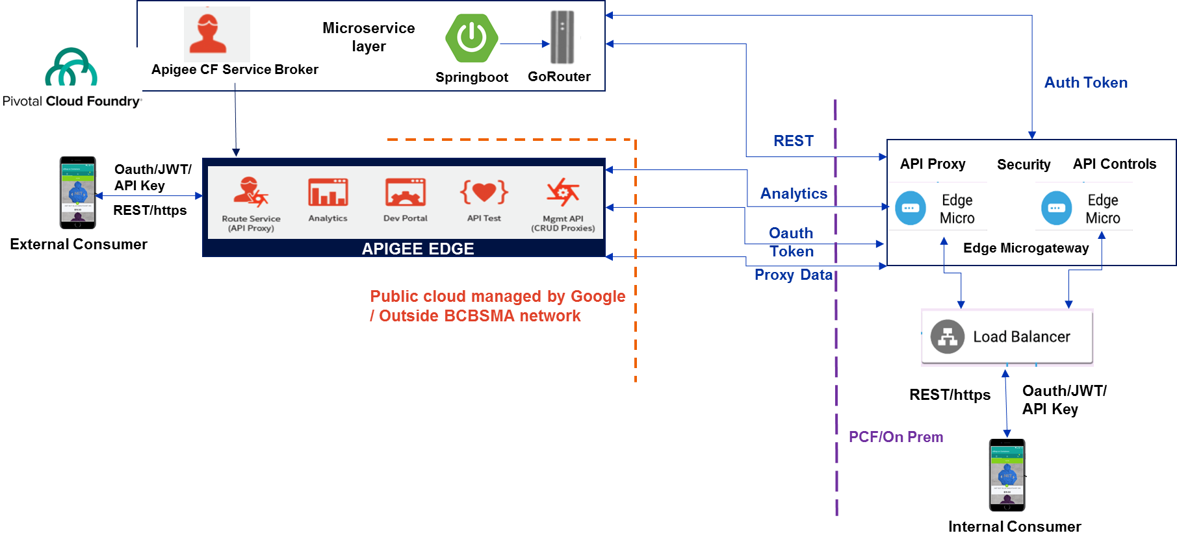
Schneider Electric – Reference Architecture
Update for SE

Slide 18
Slide on Security for SE

Slide 19










Slide on CI / CD for SE
Development Team
Source code
SCM / version control
Merge / Pull code
Code profiling
Unit test
Build & Deploy
Performance / Integration tests
Publish reports
Create / Update documentation

Slide 20
Measure APIs
APIM
Component Monitoring
API Monitoring
Runtime Analytics
Analytics
Log Monitoring
SIEM
API Score
API Monitoring
- Splunk, Sumologic, ELK, …
Log Monitoring - Splunk, Sumologic, ELK, …
SIEM
-Audit tools
Analytics
- Splunk, Sumologic, ELK, …
Component Monitoring - Splunk, Sumologic, ELK, …
API Score - How the API fared in terms of following standards and other parameters
Methodology
Build, Secure & Scale
Rapid
Concept-to-Market
1
API strategy
2
Discover
3
Design
4
5
Measure
6
Evangelize
Accelerators, Templates & Blueprints

Slide 21
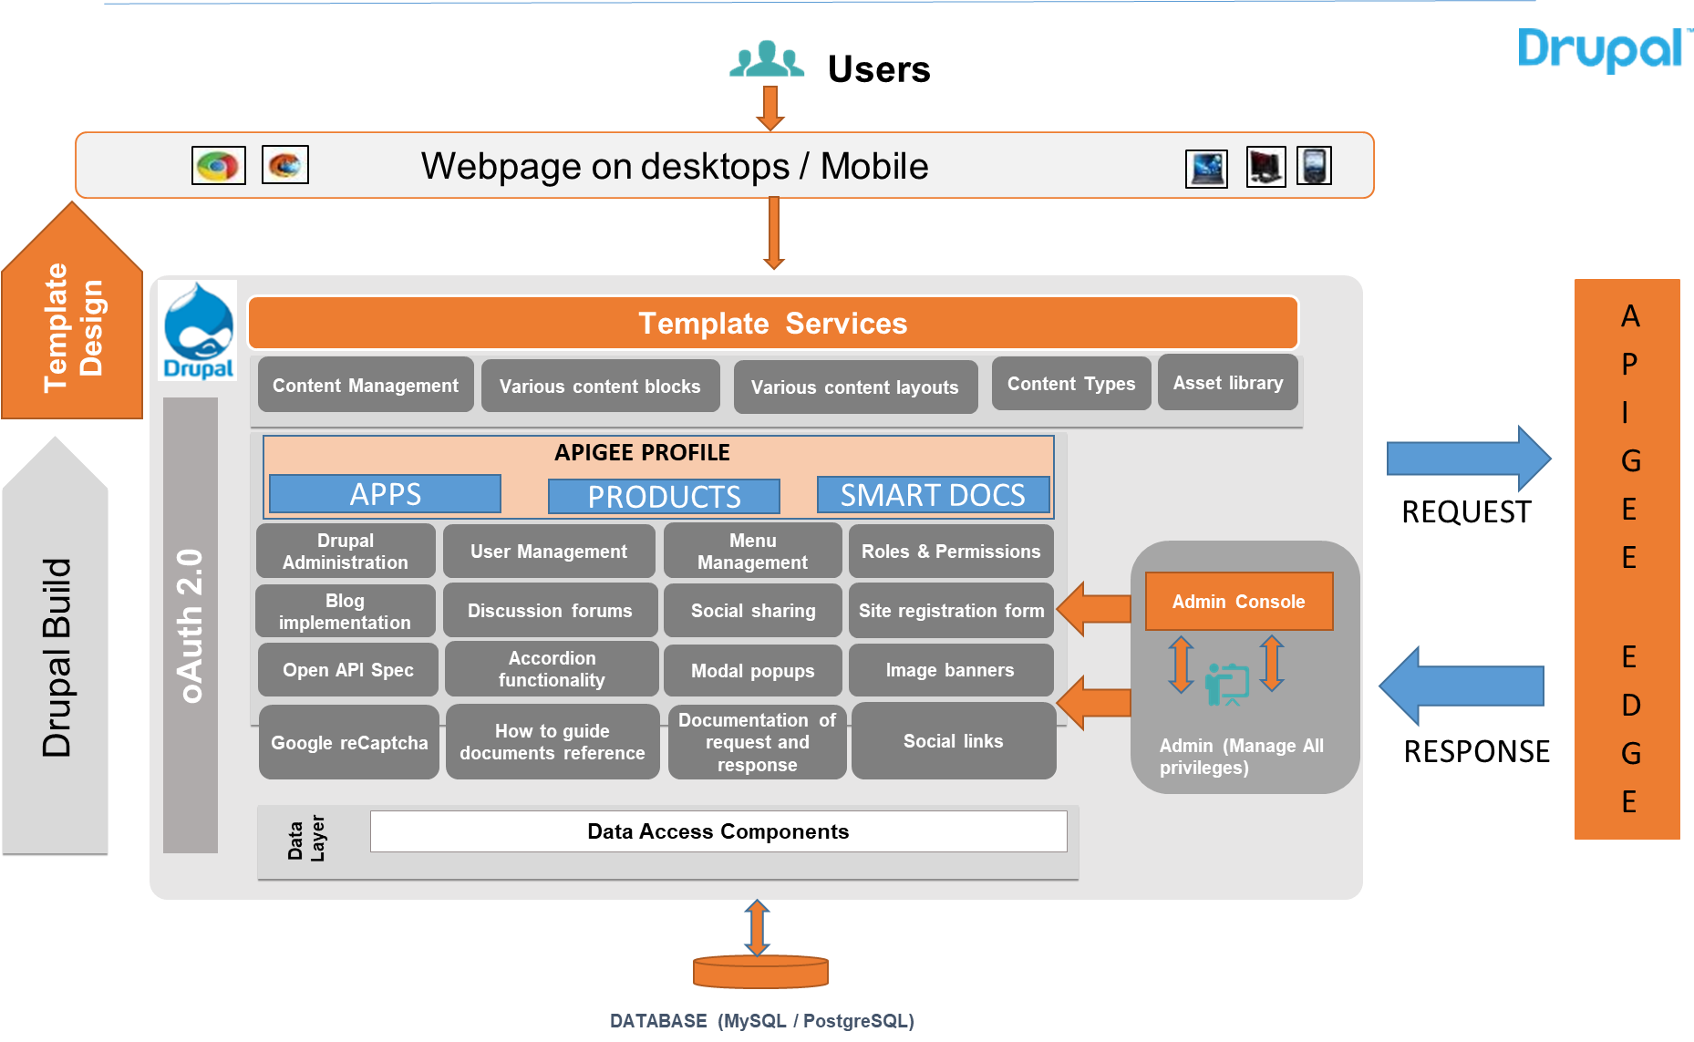



APIGEE Dev Portal Customization: Solution Architecture
APIGEE EDGE
Template Design
Template Services
Solution Approach
Content Management framework provides information on how to interact with API
Category, roles & permissions management, by which CMS pages will be separated for internal and external users
Implement Google re-Captcha to prevent spam from site web forms
CMS will have IMCE file browser for managing the media assets
APIGEE PROFILE
APPS
PRODUCTS
SMART DOCS
Admin Console
Admin (manage all Privileges)

Slide 22
Migration Approach

Slide 23


Execution approach
Migration Strategy
Model
Approach
Outcomes
Modular and Incremental
Requirements can be focused into logical groups
Learnings & Best Practices in terms of process optimization from previous lot will be incorporated on continued basis
Each Lot implementation prioritized factoring business functionality and criticality
Teams will have early view of overall migration process and provide feedback
Lower Risk in terms of execution
Staggered Model
Scope defined in terms of “lots". Each Lot undergoes a Release Lifecycle of Migration, Testing and Deployment (Production Roll-out) Phases
Approach by LOB/Partner /Business Application
Planned migration approach based on the iterations either by business functions or LOBs based on the priority needs.
Build
WSO2 APIs
Analysis and Planning
Reverse Engineer
Validation
Arch and Platform Setup
Phased /Iterative
Foundation Setups
Go Live
Pre Migration
Migration

Slide 24



Migration lifecycle
“End-to-end migration lifecycle management”
Pre-migration Analysis
Current state evaluation
Solution definition
Inventory baseline
Migration approach & business release planning
Infrastructure enablement
Schedule plan
Platform enablement
Capacity & HA planning
Detailed Architecture planning
Feature & Design planning
Reference Architecture
Decision matrix
API Patterns
Migration
Reverse engineering
Core foundation setup
Code & endpoint porting
Post Migration validation
Testing
Continuous Integration automation
Configuration validation
Deployment & operations
Go Live & cutover phasing
RunOps enablement
Business & IT user training
Knowledge artifacts
Predictable outcome
Holistic coverage:
Tailored approach – Lift n ’shift, Unit or Hybrid
Template driven for maximum reuse
Automation at all stages
Cost benefits (resourcing, replicable and controlled-risk)
Optimal Timeline (flexibility for business and feature releases)
Ease of new feature deployment

Slide 25
Migration Plan – Key Activities & Deliverables
DELIVERABLES
Migration Components
Execution Steps
AS-IS PLATFORM ANALYSIS
API Governance Process
Document API products, API Categories such as internal/external APIs
API governance process, such as versioning and decommission
Current State Assessment
AS-IS COMMON COMPONENT ANALYSIS
Common Development Frameworks
Analyze WSO2 setup for common policies/processes:
Authentication/Authorization framework.
Logging framework
Error handling framework
Rate Limits (spike/quota)
Request/Response Validation
Request/Response transformation components.
PRODUCT MIGRATION
API Products
Document AS IS product creation steps.
COMMON COMPONENT DESIGN
Common Development Frameworks
Analyze configuration requirements such as KVM and Target servers for APIGEE.
Analyze and plan if below can be created as Shared flows in APIGEE and be added to the template:
Authentication/Authorization framework (such as OAuth Implementation)
Logging framework
Error handling framework
Rate Limits (spike/quota)
Strategy, Roadmap and Blueprinting
API Migration
API MIGRATION
API Products
API Proxies
environment configurations such as KVMs and target servers.
Create common shared flows for API proxies and flow hooks.
Provide API specifications from WSO2 as input to the CTSAPIMAKR and create APIGEE proxy bundle and products using CTSAPIMAKR.
Perform required manual updates on Proxies: for custom code specific to proxy.

Slide 26
Migration Approaches : Requirements
Phased Migration | Big Bang
Eg Create API lots based on Consumer agreement as API URL and credentials will be updated. | Eg. All APIs will be in Production in one go without any impact to consumers with no change in API URL and credentials

Slide 27
Migration Approaches : Comparison
Phased Migration | Big Bang
PROS | PROS
CONS | CONS

Slide 28
Execution Plan
Indicative
PHASE | W1 | W2 | W3 | W4 | W5 | W6 | W7 | W8 | W9 | W10 | W11 | W12
Current State Assessment
Project initiation
Assess existing integration and API patterns and infrastructure
Gather and Assess API Requirements
Identify and Prioritize API Use Cases
Strategy, Roadmap and Blueprinting
Develop API Governance and Operating Model
Outline Change Management Requirements to implement API processes, organization and Governance
Define API Reference Architecture
Determine Potential API implementation scenarios
Show migration related steps
API Migration
Implement MVP APIs in Apigee platform
Define and Showcase best practices
Developer Portal PoC
Developer Portal POC Planning and next steps
Other API Initiatives
Understand the Existing documentation and put forth a plan to create Open API specifications

Slide 29
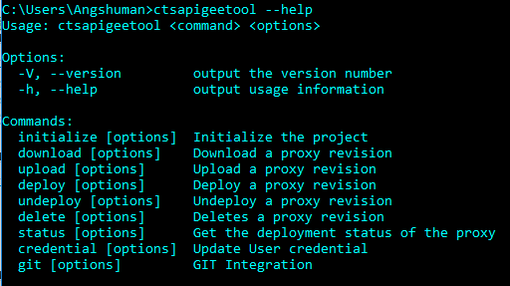
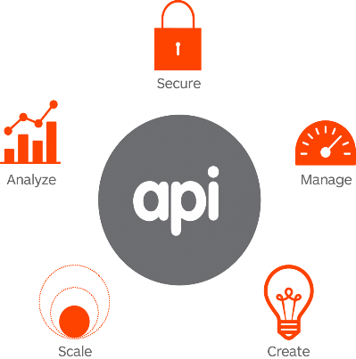








APIGEE Migration: Tool based
Import
Generate
Build/Deploy
Run
Import Project and Customize
OAS
Create Project
Include Maven dependencies
Assign APIGEE policies
Generate Test Suite
Create Env. Configuration
Config Mgmnt /Deploy API
Run Test cases
Add API Products
Before Migration
Step 1
Step 2
Step 3
Step 4
API Template Design Organization specific templates with required Policies
Implement Template
and integrate with APIMakr
Setup DevOps Model
Customize APIMakr to meet Org Specific DevOps Model or
Enable Accelerated best in class API build using APIMakr

Slide 30
Appendix

